Slide 1



JUL, 8th | PARIS
Speech Emotion Recognition
Natanael PITOUN
DAFT MAY22

Slide 2

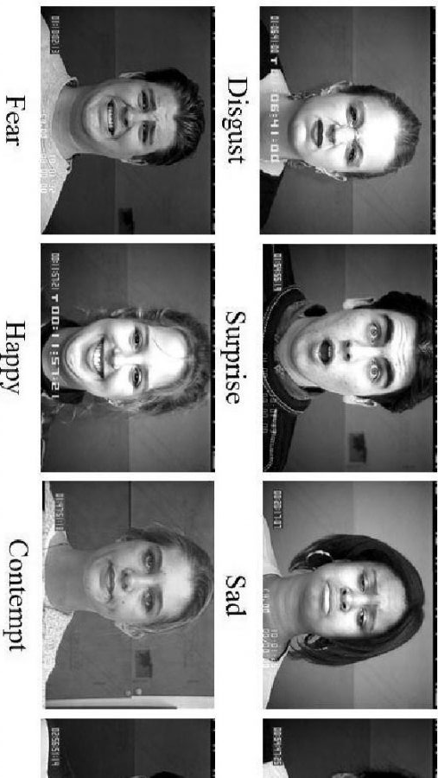
GOAL / Business Case
Human Emotion Reading through Vocal Characteristics
Being able to recognize emotion in the context of increasing distanced communications can:
Bring valuable insight into the situation of the speaker
the attitude towards the audience
Her view of the topic in question
Fit a response/Approach to a target
Applications:
Profiling
Customer satisfaction
Live Call Center Usage

Slide 3




The Plan
Import the files and necessary libraries
Librosa
Good Ol’ Numpy, Pandas,..
Processing / Extraction of valuable feature
In this case, had to “make” the data
EDA (Exploratory Data Analysis)
Modelling
Tuning the models & reprocessing
REPEAT

Slide 4
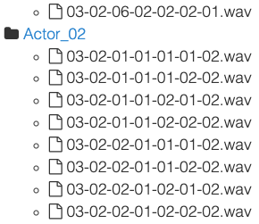

The Ryerson Audio-Visual Database of Emotional Speech and Song (RAVDESS)
Gender Equal Open Access Database (12/12)
Consist of .wav Audio Files arranged in Song/Speech folders
and Actor# subfolders
Regular Speech and Songs by actors
8 Emotions: Neutral, Calm, Sadness, Happiness, Anger,
Surprise, Disgust & Fear
Two levels of emotional intensity (normal, strong) & Neutral expression
Reliable data tested for those 8 different emotions by 247 individuals
The database includes video recordings (useful for Image/Sound crossover studies)

Slide 5
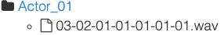
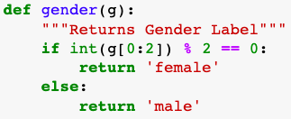
Initial Exploratory Data Analysis
Let’s look at the information we have from the get go…
8 elements can be extracted:
File type: Audio-only (03)
Song or Speech: (02)
Sentiment: Calm (01)
Intensity: Normal (01)
One of Two Statements "kids" (02)
First or 2nd repetition: (01)
Actor Number: (12)
Gender (induced): Male, as the actor ID number is uneven
After Research, the most important for our purpose were selected to initiate our data:
Sentiment (our y -what we are testing for-)
Gender (since the distinction can slightly improve accuracy score by explaining variations in tone)

Slide 6
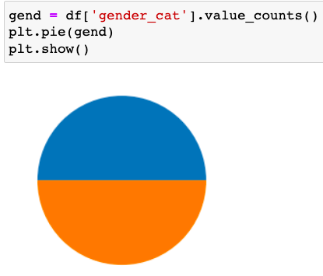
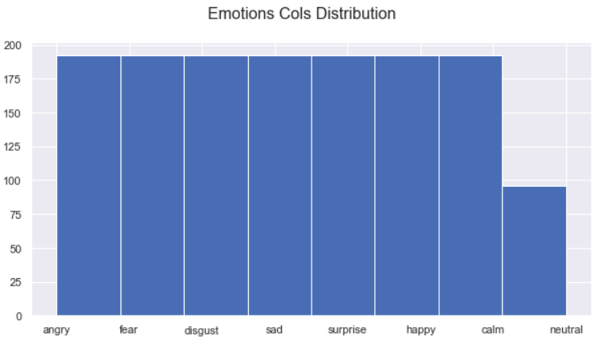
EDA
After looping true the audio files.. Checking everything is in order
After some testing, Neutral & Calm were dropped to retain the 6 basic human emotions according to Pr. Eckman, Phd

Slide 7
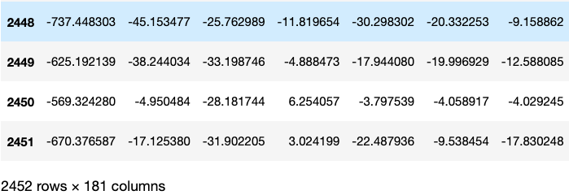
Feature Extraction
How to go from sound to a bunch of numbers a computer can predict human emotion on?
Unlike most tools & models which need to understand the words, we want to capture the emotion

Slide 8
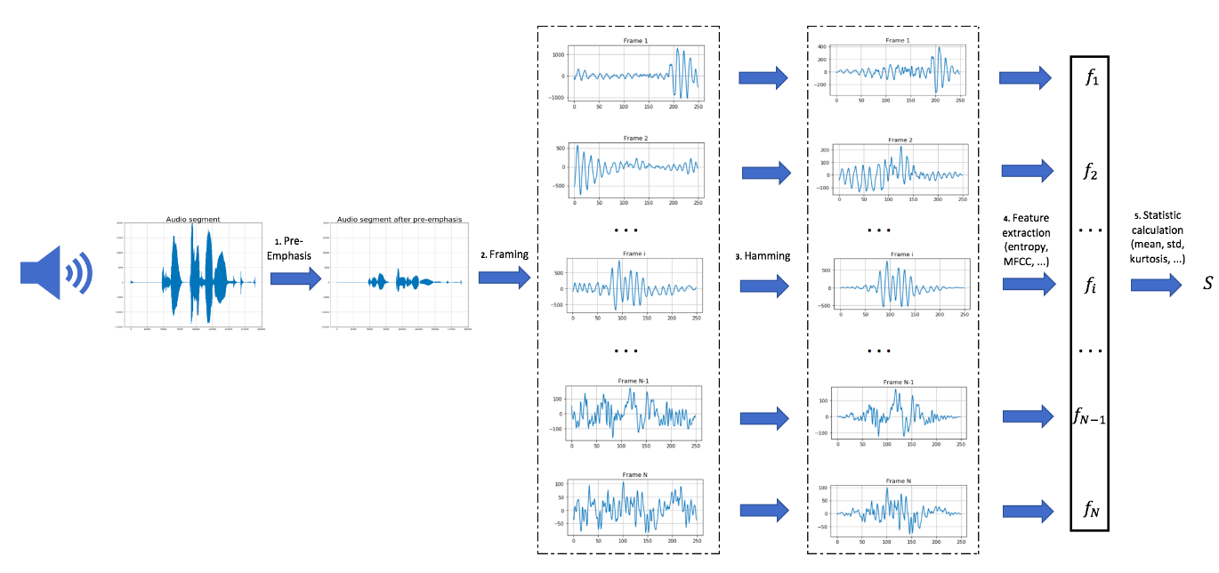
Feature Extraction & Preprocessing
Feature Extraction
“Prepping” the sound so the future values we get are more meaningful
4 steps are usually involved:
Pre-Emphasis
Framing
Hamming (not done to not risk losing features)
Feature extraction & The Fourier Transform

Slide 9
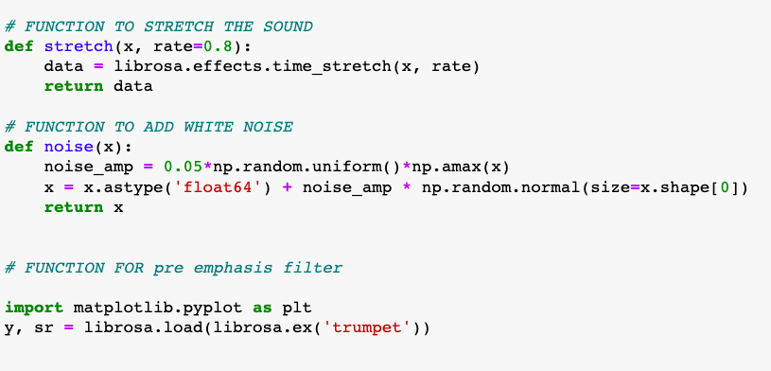
Other Preprocessing Functions
Despite the stretch and white noise being widely used in sound preprocessing, I did not find them useful for the purpose of determining emotion

Slide 10
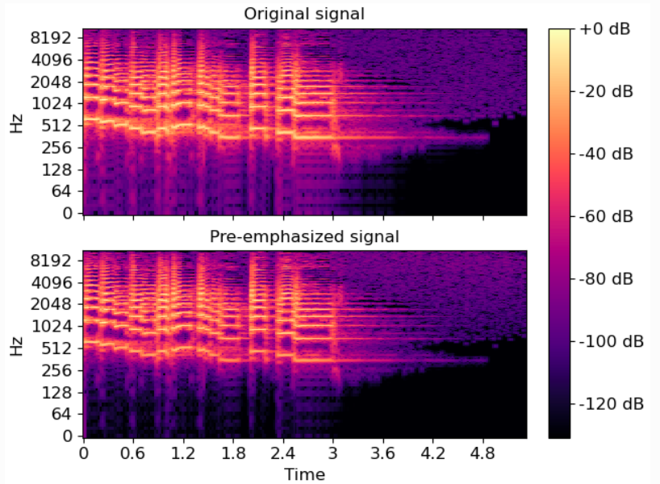
Preprocessing: Pre-Emphasis
Amplify high frequencies

Slide 11
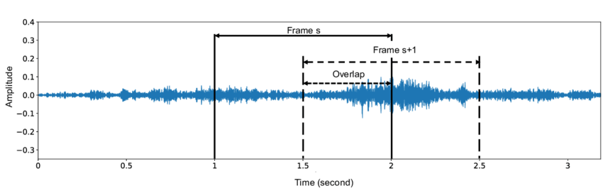
Preprocessing: Framing
A frame contains amplitude (loudness) information at a point in time. Here we take snapshots every x seconds and make them overlap by 50%
Helps make the final data more ‘compact’

Slide 12
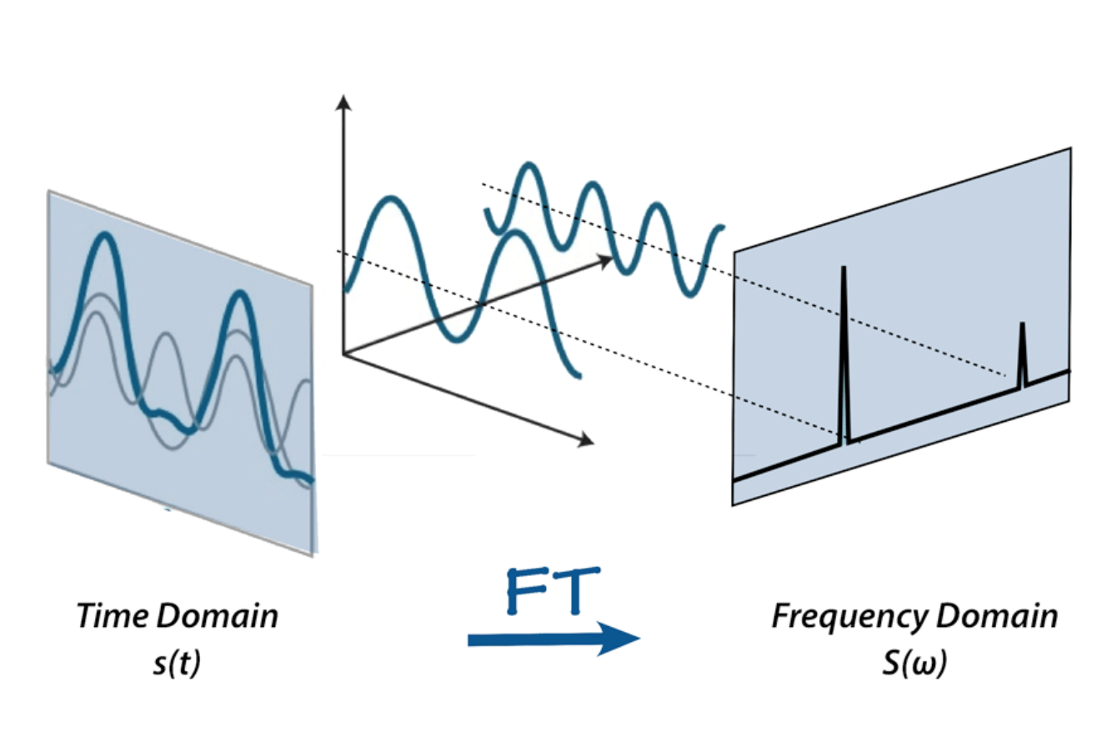

Preprocessing: The Fourier Transform
A mathematical formula that allows us to decompose a signal into it’s individual frequencies and the frequency’s amplitude.

Slide 13
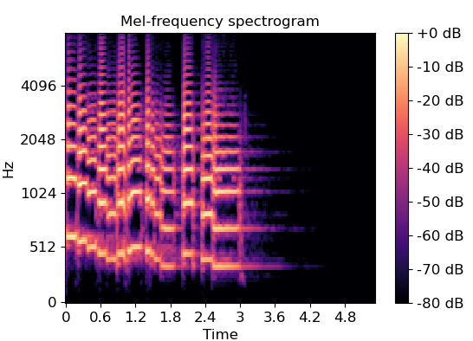

The Features: Mel-frequency cepstral coefficients (MFCCs)
“ A representation of the short-term power spectrum for a sound, based on a linear cosine transform of a log power spectrum on a nonlinear mel scale of frequency ”.....
= One of the features the literature considers important in emotion reading

Slide 14
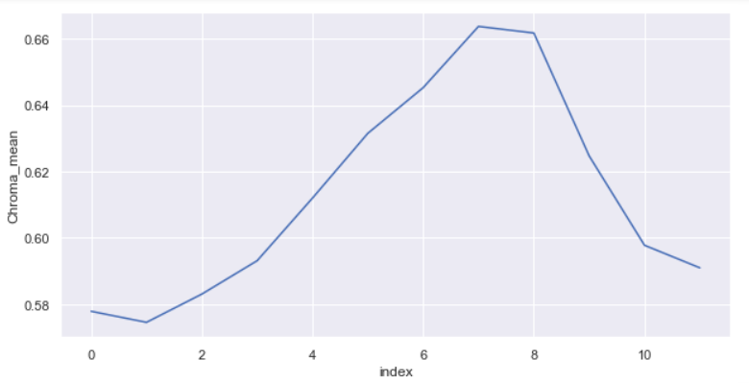
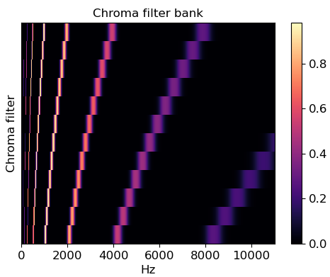

The Features: Chroma
A linear transformation matrix to project FFT bins onto chroma bins (i.e. pitch classes)

Slide 15
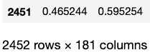
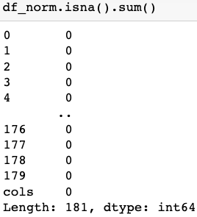
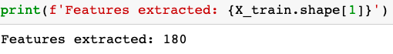
Some More EDA …
No Missing values
An Initial 2452 Sang & Spoken Sentences
1 Emotion column (encoded in integers)
180 columns representing our sound properties transformed into arrays (list of numbers)

Slide 16
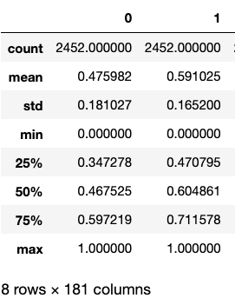
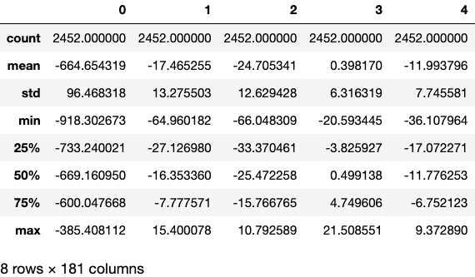


Before & After Scaling
Standardizing all values to between 0:1

Slide 17

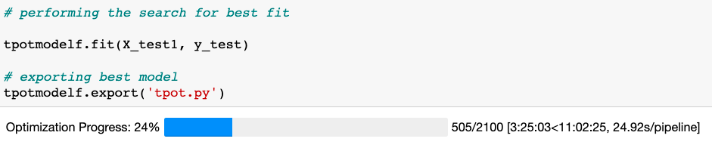
Now…. The Fun Part: Modelling
Many features, Many manipulations …
A lot of going back and forth between running models
Reprocessing sound to re-extract features with different filters & functions

Slide 18
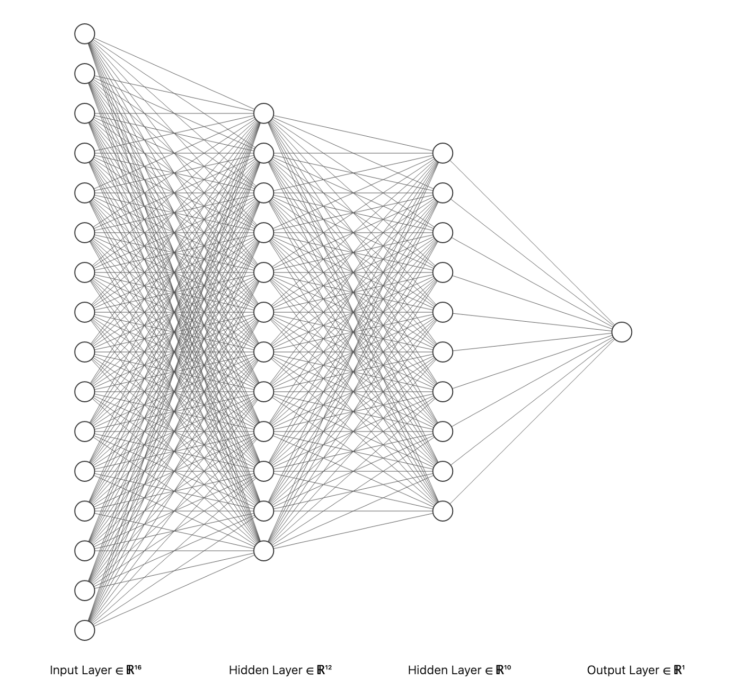
Modelling
Some models I have considered for this study:
The Gaussian Classifier
The MLP (Multi Layer Percetron)
The Decision Tree Classifier
The Logistic Regression Classifier
All Supervised Learning Models,
Since we knew what to test

Slide 19
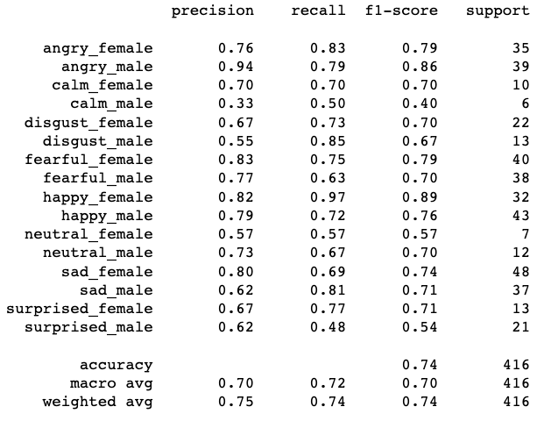
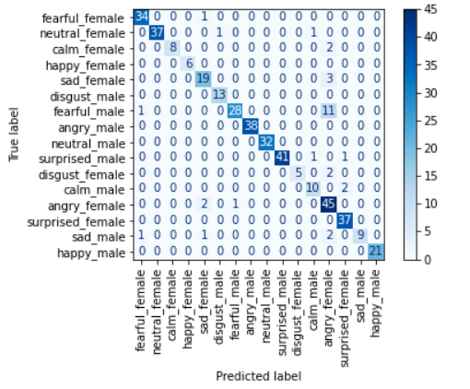
Best (Proved Result) with MLP
The best here: the MLP with Gaussian & LogReg
A Neural Network model (works like a brain)

Slide 20
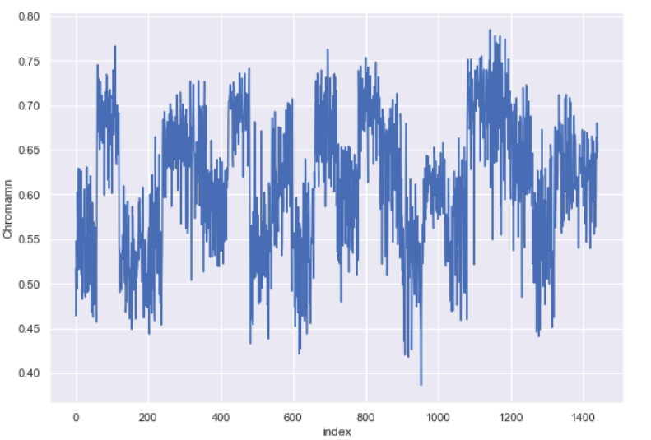
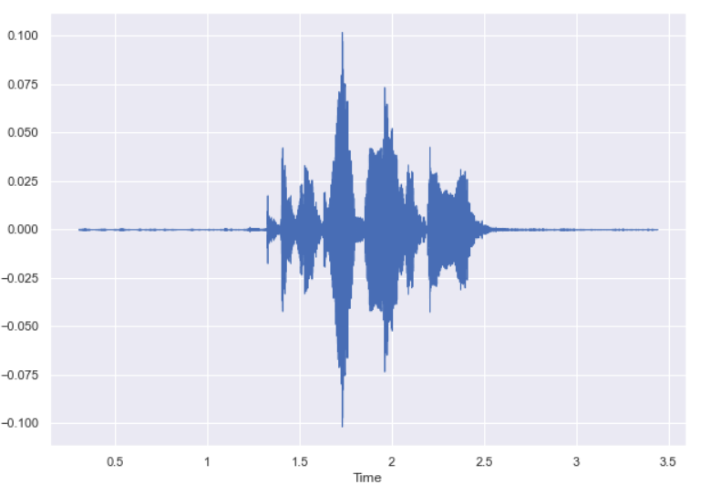


Conclusion
75% Accuracy
A lot of testing and sound processing
Limitations: The subjectivity of Human Emotion
Future Studies: Include Facial expression & Body Language, Deep Learning
Mean Chroma
Best predicted… Happy Female & Angry Male…
Initial Sound Plot

Slide 21

I would now love to answer your questions
Thank You
https://web.stanford.edu/class/cs224n/reports/final_reports/report043.pdf
https://numpy.org/doc/stable/reference/routines.fft.html
https://github.com/RoccoJay/Audio_to_Emotion
Repo on https://github.com/gastryphon/Speech-Recognition---Final-Project
RAVDESS Dataset from https://zenodo.org/record/1188976

